Slide 1
DDOS attacks Detection based on RDF-SVM
Batch-16
By
K.Yasaswi (Y16CS869)
K.Vamsi (Y16CS882)
N.Sai Phanindra (Y16CS905)
Guide: Sri.CH.Ratna Babu

Slide 2
ABSTRACT
Effective Detection of DDOS Attacks.
Detection based on feature selection.
Exploiting Random Forest for computing feature importance.
SVM used to rescreen the features.
Finally, an optimal feature subset is obtained, which will reach a higher detection rate and recall rate.

Slide 3
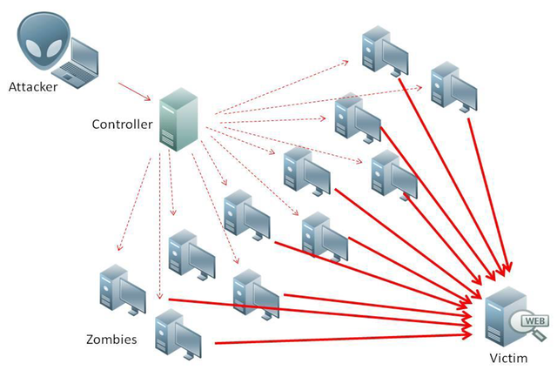
DDOS
Distributed denial of service.
Strategies at Application layer:
1. Server load.
2. Increasing.
3. Constant.
4. Target Web Page.
5. Main page attack.
6. Dominant web page.

Slide 4
DDOS
Types of DDOS:
1. Session Flooding Attack.
2. Request flooding Attack.
3. Asymmetric Attack.
4. Slow Request/ Response Attack.

Slide 5
Existing Techniques and their drawbacks
CUSUM-based detection technique.(New IPs)
Drawback: 1)during flash crowds IP addresses may not be new.
2)Attack can be performed with known IP addresses.
Technique based on dynamic statistical properties of the network traffic.
Drawback: Change in TTL values always does not effect anomalous
traffic.

Slide 6
Contd..
Technique based on Distance.
a)Average Distance estimation.
b)distance-based Traffic separation.
Drawback: Distance will not reflect anomaly of traffic.
MULTOPS (MULTI- Level Tree for Online Packet Statistics)
Heuristic and data structure based technique.
Packet rate statistics are collected and maintained at Nodes of tree.
Drawback: Location and setup of routers may affect the technique.

Slide 7
Proposed Algorithm RDF-SVM
Combination of RANDOM FOREST and SVM.
Random Forest:
- Large collection of decorrelated decision trees.
- Construct multiple decision trees randomly, and gains the final classification result by voting.
3. SVM:
performs well in generalization and handling with imbalanced dataset.

Slide 8
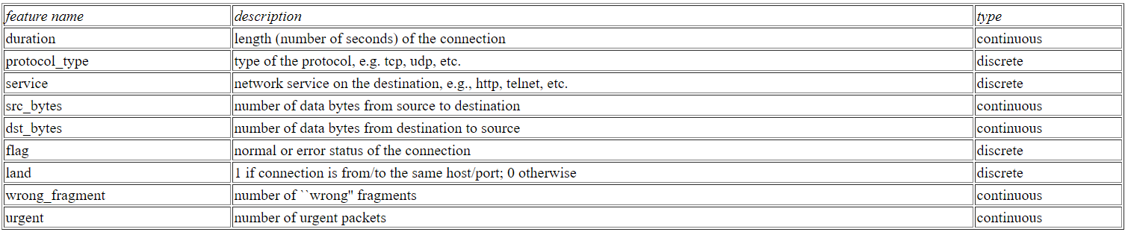
KDD99 DATASET

Slide 9
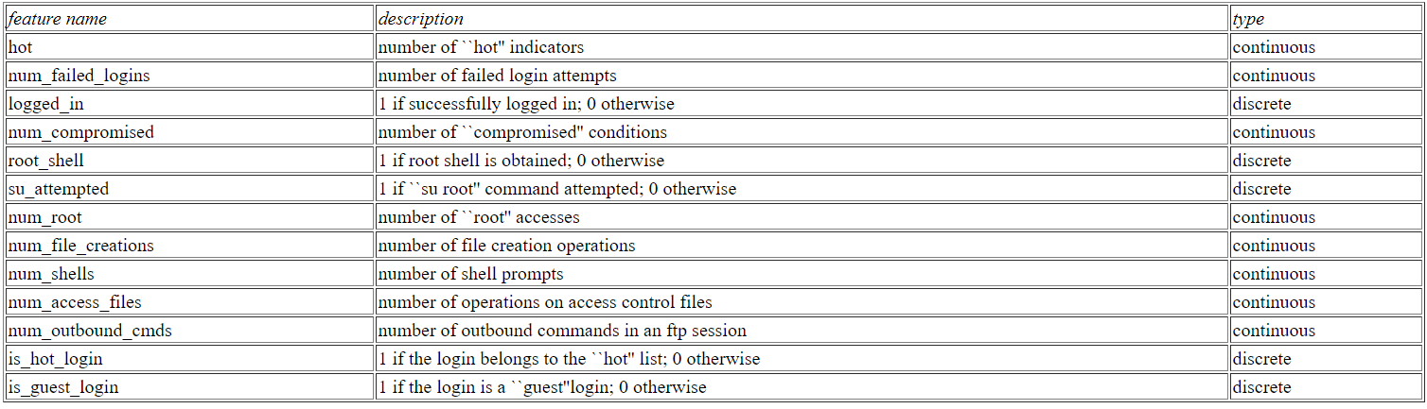
KDD99 DATASET

Slide 10
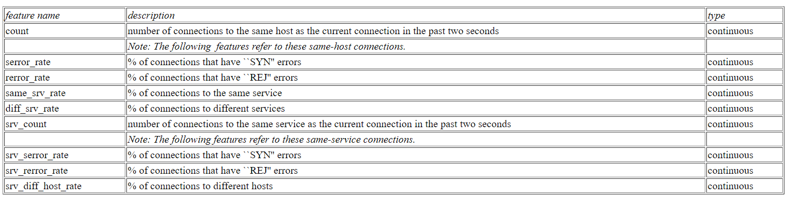
KDD99 DATASET

Slide 11
Module Description
Module 1: Preprocessing the data.
Module 2: Feature subset by random forest by sorting the importance values of
features.
Module 3: Classification by SVM and getting optimal feature subset by sum_P
values.
Module 4: Evaluation and Testing.
Module 5: Report writing.

Slide 12
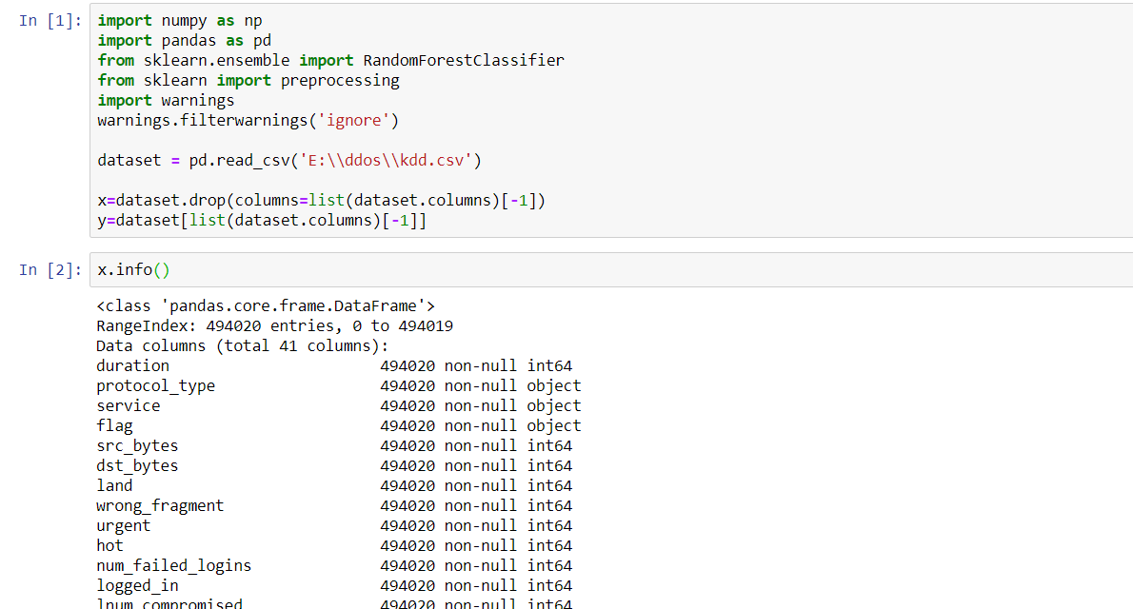
Implementation

Slide 13
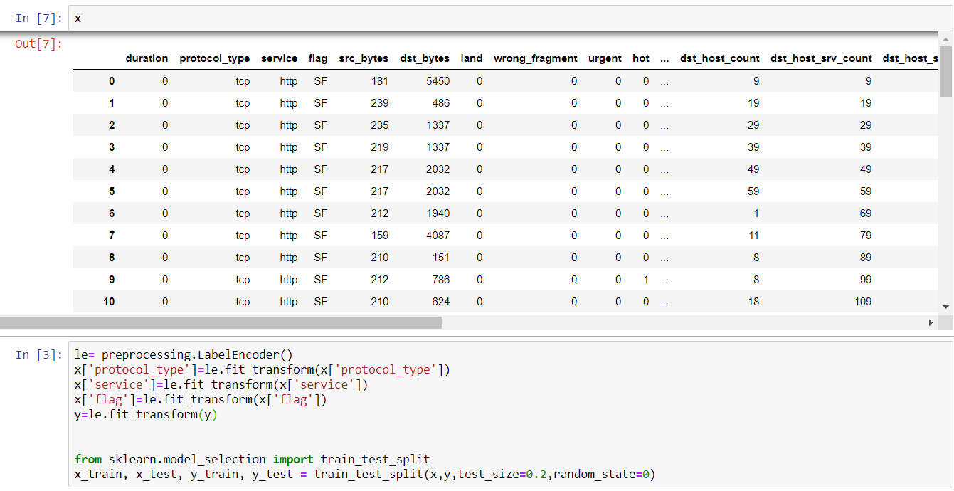
Contd..

Slide 14
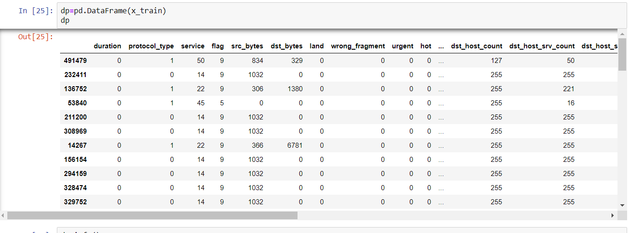
Contd..

Slide 15
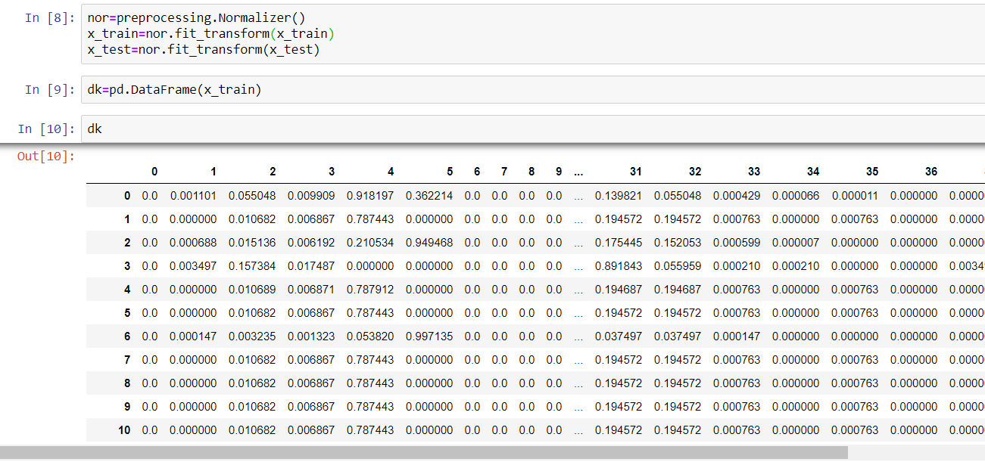
Contd..

Slide 16
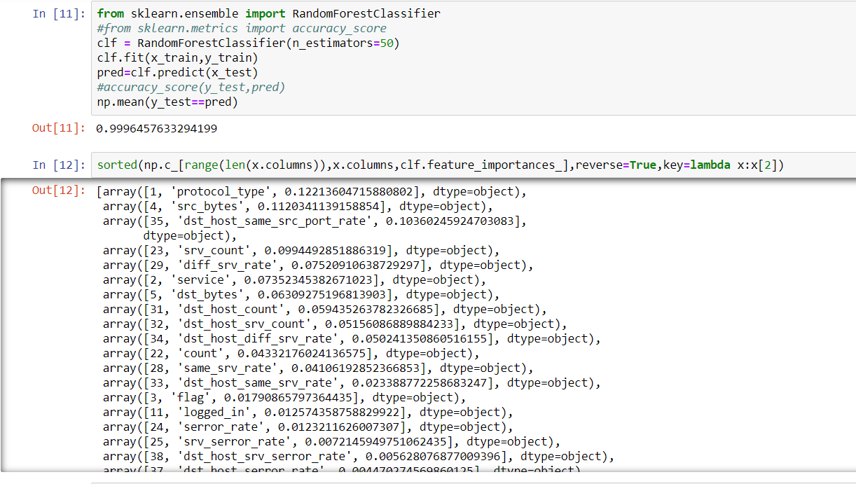
Contd..

Slide 17
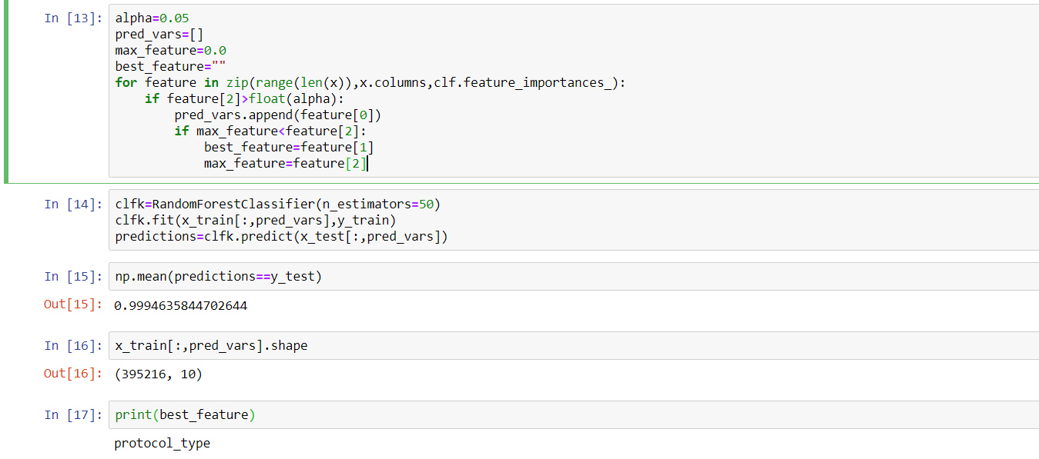
Contd..

Slide 18
Thank You

